Slide 1

Notes:
Holding slide for the start of the show as audience enters.

Slide 2
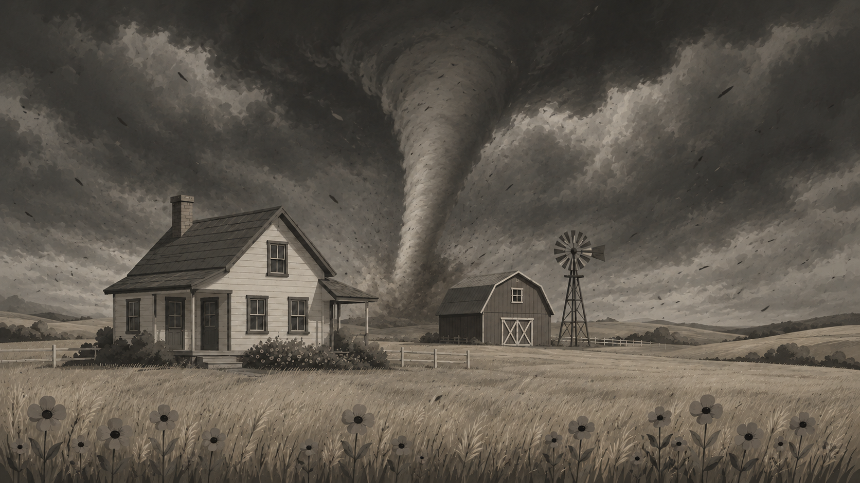
Notes:
Use during song 'One Day In Kansas’.

Slide 3

Notes:
Act One, Scene One - Dorothy Arrives In Oz

Slide 4
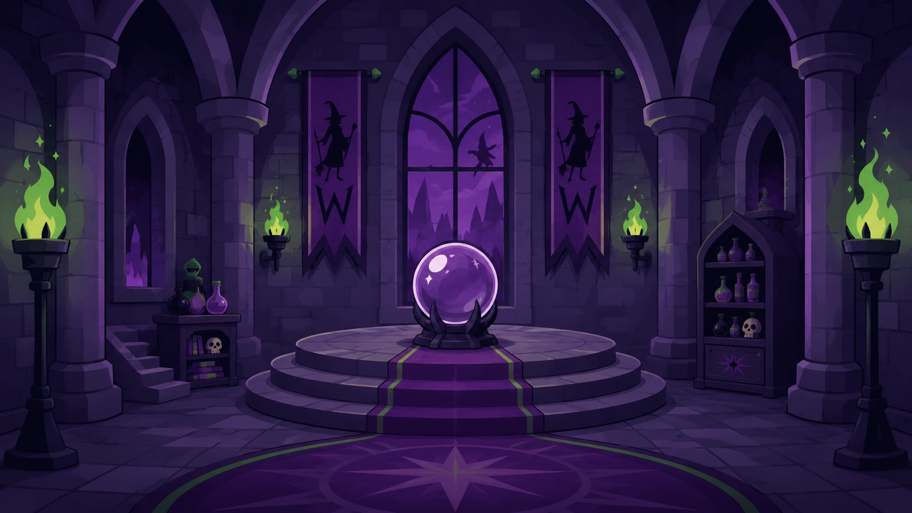
Notes:
Act One, Scene Two - The Castle Of The Wicked Witch Of The West

Slide 5

Notes:
Act One, Scene Three - The Road Of Yellow Brick

Slide 6
Notes:
Act One, Scene Four - Back In The Castle Of The Wicked With Of The West

Slide 7

Notes:
Act One, Scene Five - A Meadow Of Scarlet Poppies

Slide 8

Notes:
Act One, Scene Six - The Gates Of The Emerald City

Slide 9
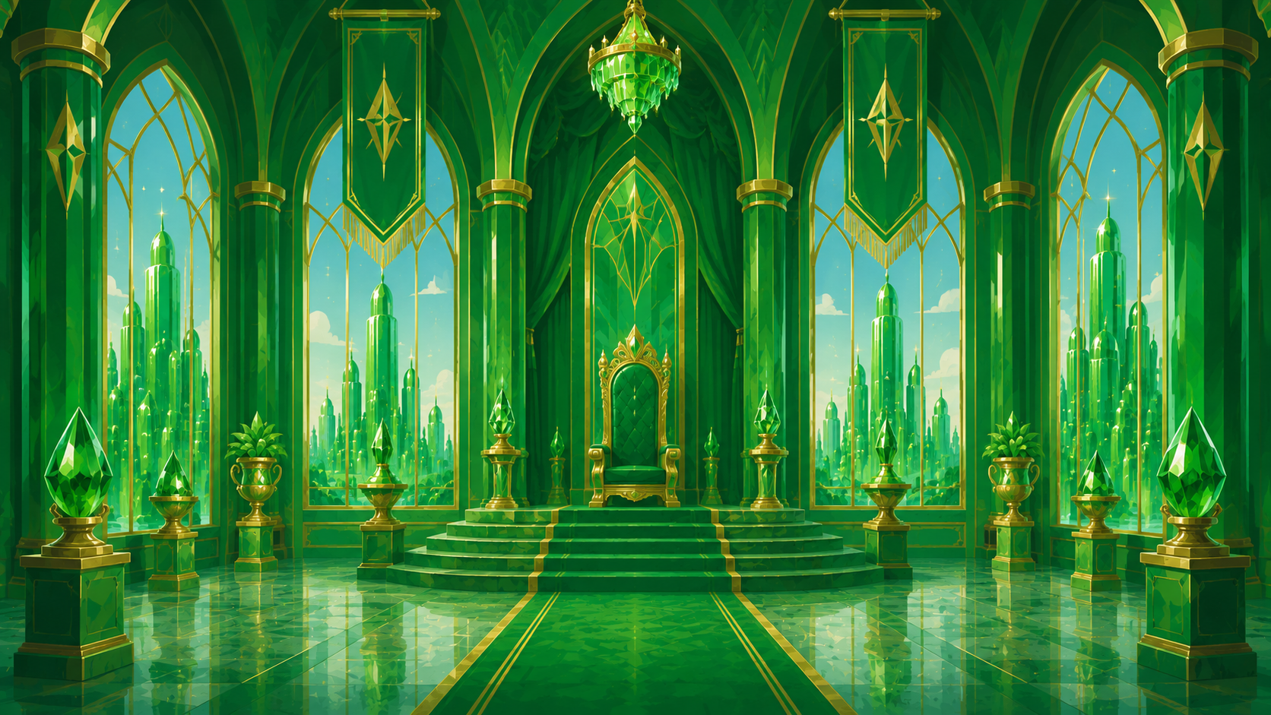
Notes:
Act Two, Scene One - Inside The Throne Room In The Emerald City

Slide 10
Notes:
Act Two, Scene Two - Back In The Wicked Witch Of The West's Castle

Slide 11

Notes:
Act Two, Scene Three – On the road away from the Emerald City

Slide 12

Notes:
Act Two, Scene Four - The Wicked Witch, Pacing And Muttering

Slide 13
Notes:
Act Two, Scene Five - Back Inside The Wicked Witch Of The West's Castle

Slide 14

Notes:
Act Two, Scene Six - At The Front Of The Main Doors Of The Emerald City

Slide 15

Notes:
Act Two, Scene Six - Change Slide After Everyone Finishes Singing 'There's No Place Like Home'

